Slide 1
AIRPORT MANAGEMENT SYSTEM
Developed By:
Irfan Danish
KHIZAR HAYAT
Ali FErzain

Slide 2
Introduction:
Airport management system that can manage.
Passenger info's
Security Employee
Catering
Ticket
Employee info

Slide 3
Previous version
we designed Airport Database System. The system lack some features and also had some drawbacks. It was all console based, not user friendly. It lacks efficiency to remove, update and modify employee data, Flight data, seat reservations and their cancelation request, flight departure and arrival timings. Now keeping in view all the drawbacks and vulnerabilities we have developed this project.

Slide 4
Features of project
Provides Graphical User Interface.
User Friendly.
Easy to add, update and modify records.
Flight Timings .
Add & manipulate Employee data.

Slide 5
Security Employees Data.
Catering management for flights.
Seat reservations
Security guards timings and their names

Slide 6
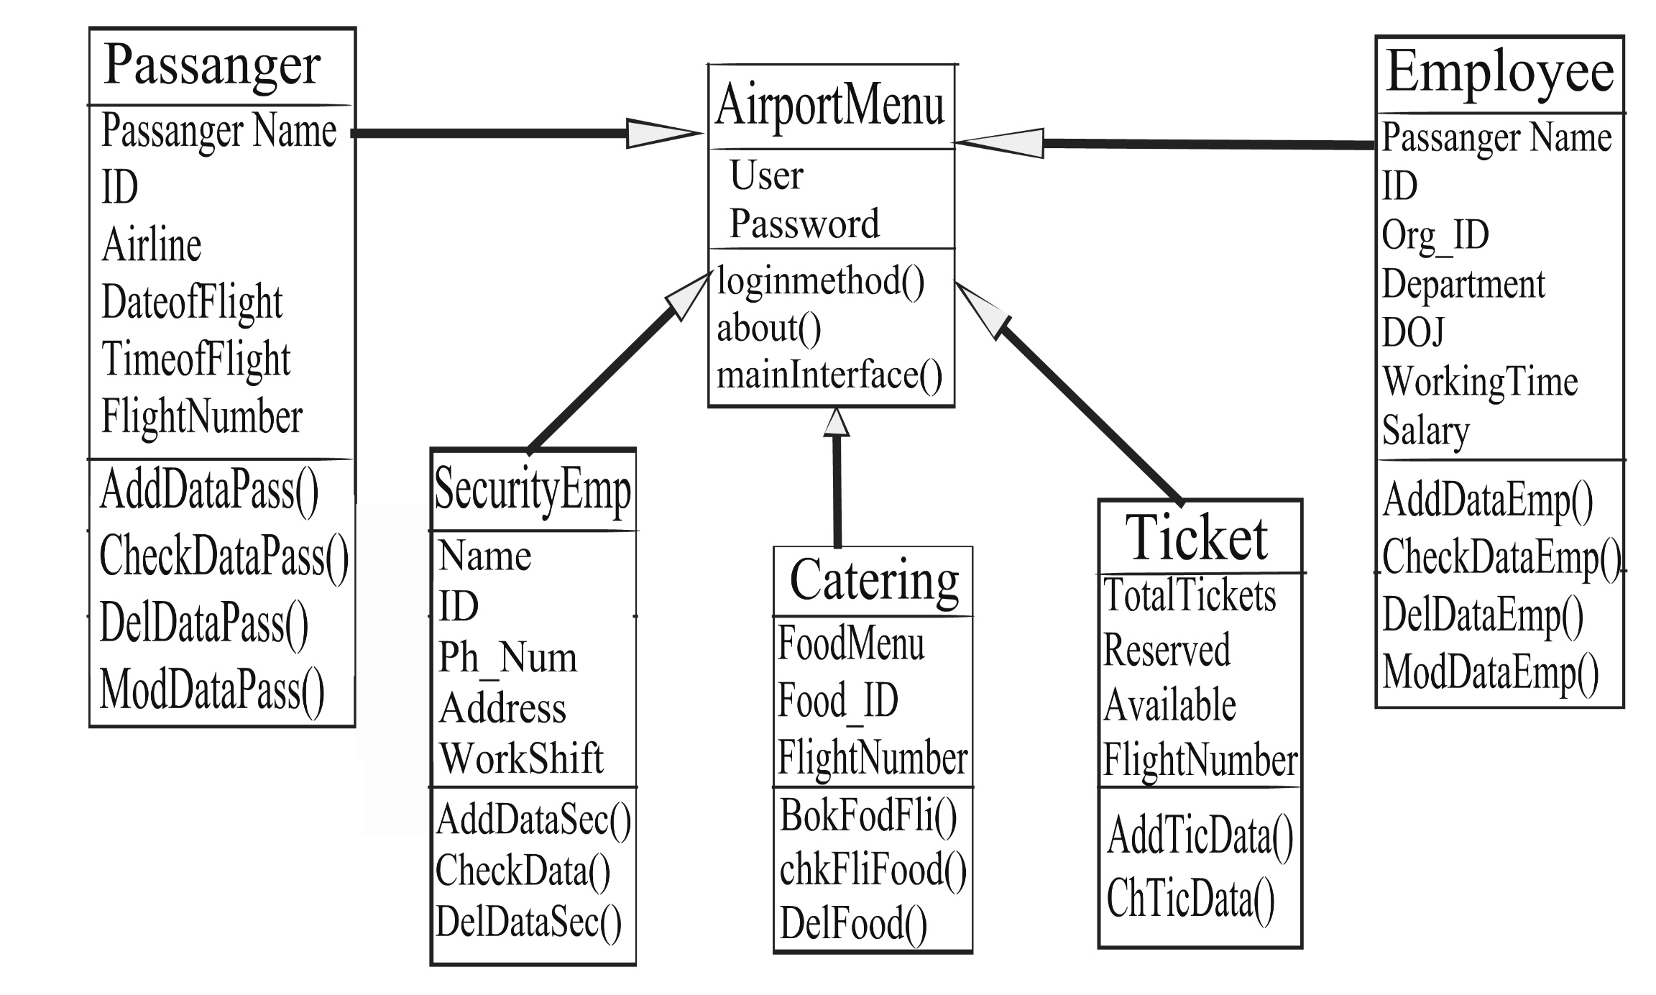
Class Diagram

Slide 7
Now Lets See Coding Behind This Project

